Slide 1
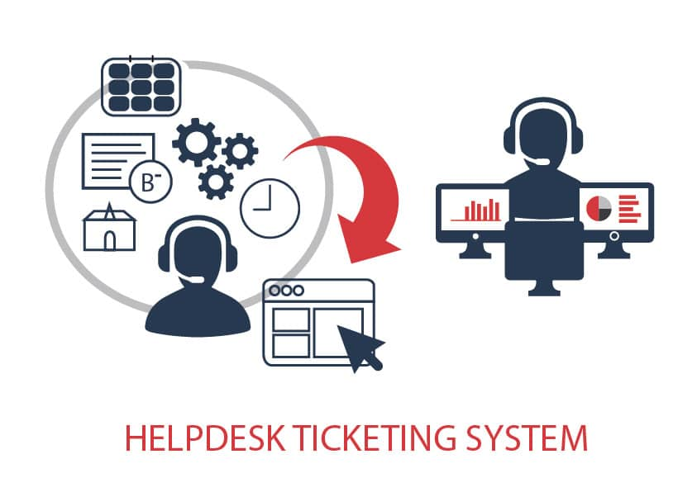
Helpdesk Support Data Analysis Using SQL

Slide 2

Introduction
A helpdesk system manages customer/user support tickets.
Each ticket contains information such as category, priority, status, dates, and resolution.
SQL is used to store, manage, retrieve, and analyze this information.

Slide 3
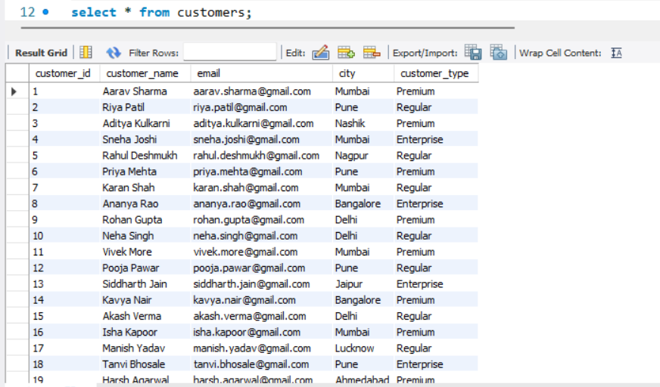
Helpdesk_analysis database
Table 1 - customers

Slide 4
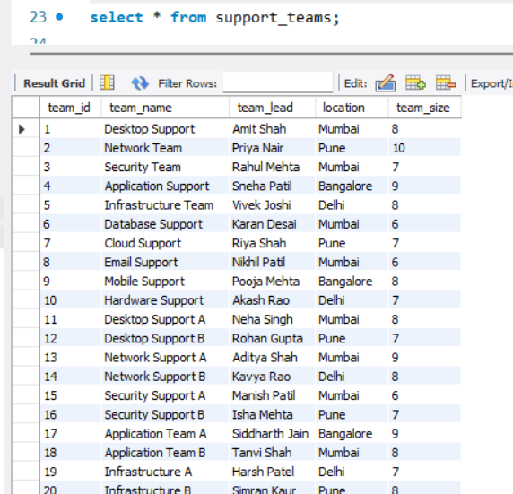
Helpdesk_analysis database
Table 2 - support_teams

Slide 5
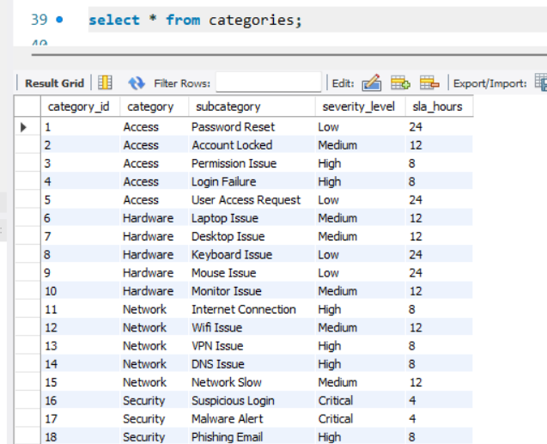
Helpdesk_analysis database
Table 3- Categories

Slide 6
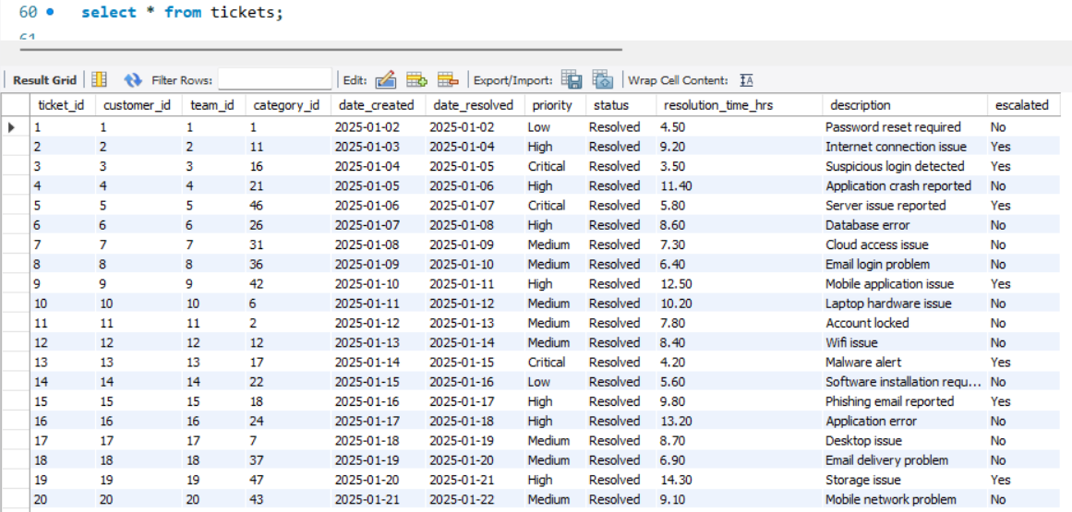
Helpdesk_analysis database
Table 4 - Tickets

Slide 7

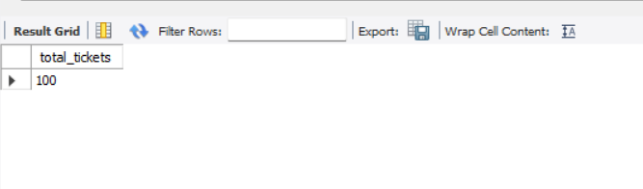
Display the total number of tickets
Total number of tickets

Slide 8
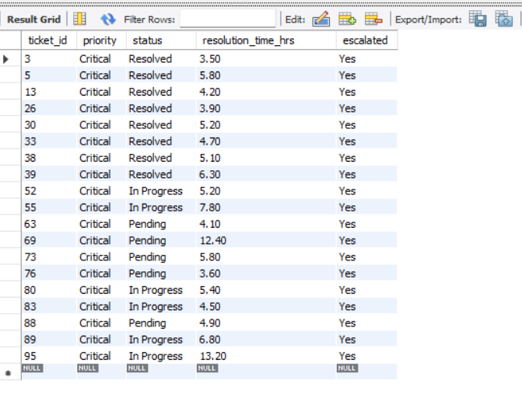
Where clause
Critical Tickets

Slide 9

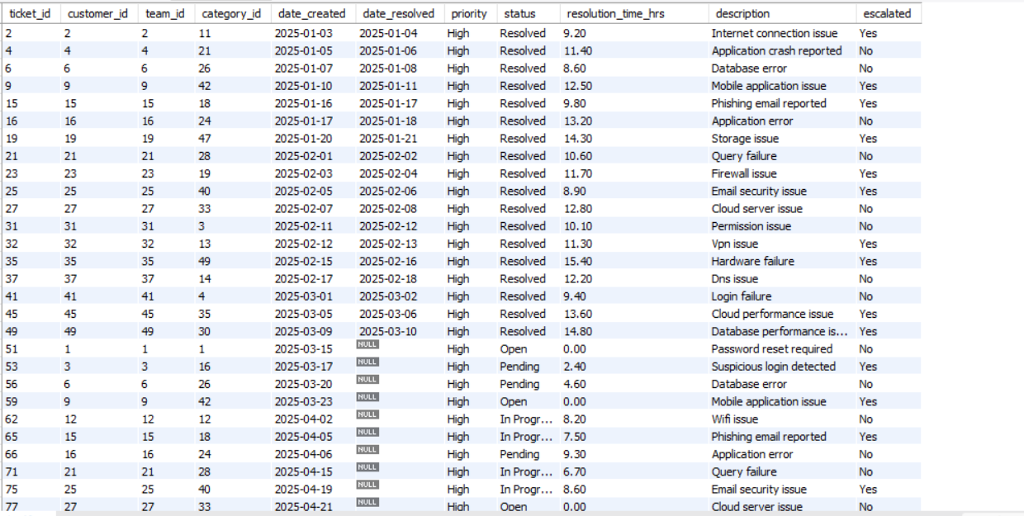
Highest Priority tickets
Find high priority tickets

Slide 10

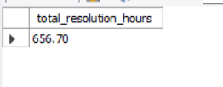

Aggregation function
Total resolution hours
Average resolution time

Slide 11

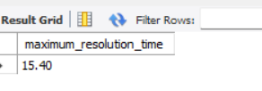

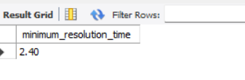
Min & Max function
Maximum resolution time
Minimum resolution time

Slide 12
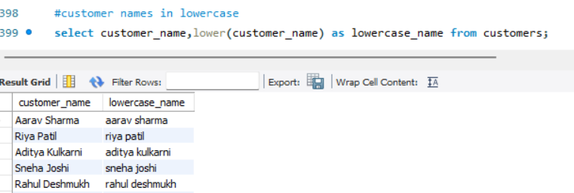
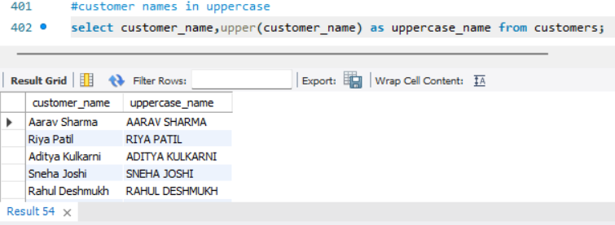
String function
Customer names in lowercase
Customer names in uppercase

Slide 13
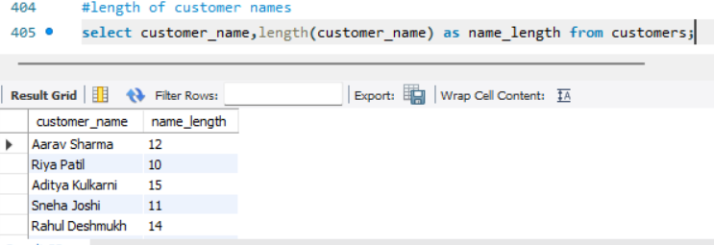
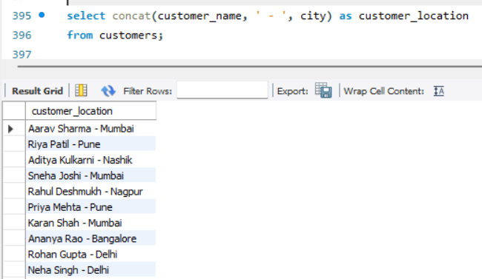
Length and concat
length of customer names
Combine customer name and city

Slide 14
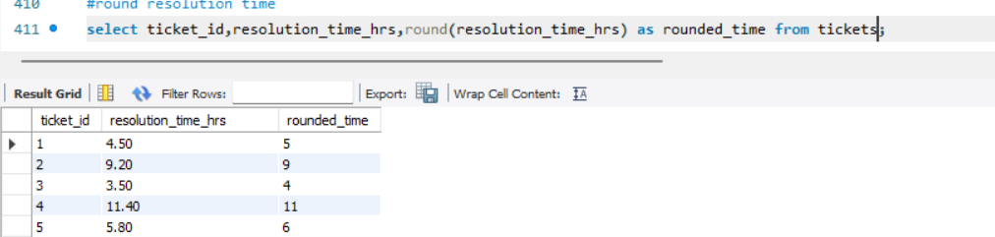
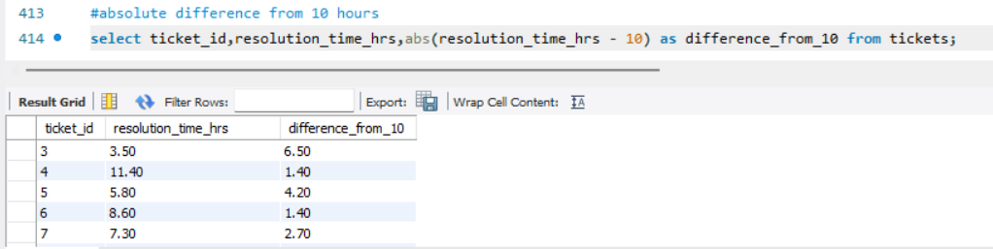
mathematical functions
Round resolution time
Absolute difference from 10 hrs

Slide 15
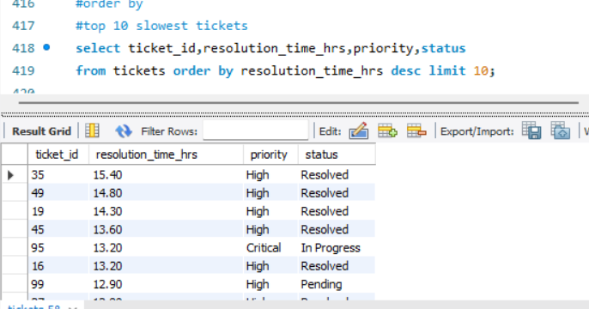
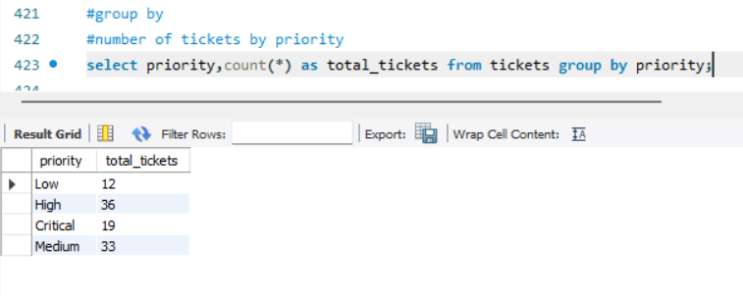
Order by and group by
Top 10 slowest tickets
Number of tickets by status

Slide 16
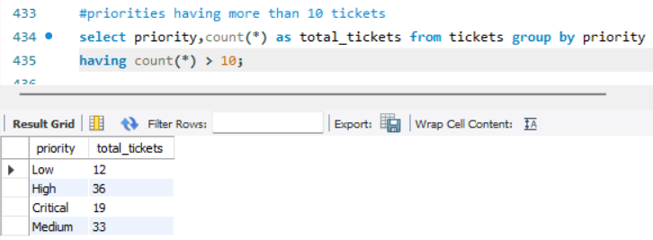
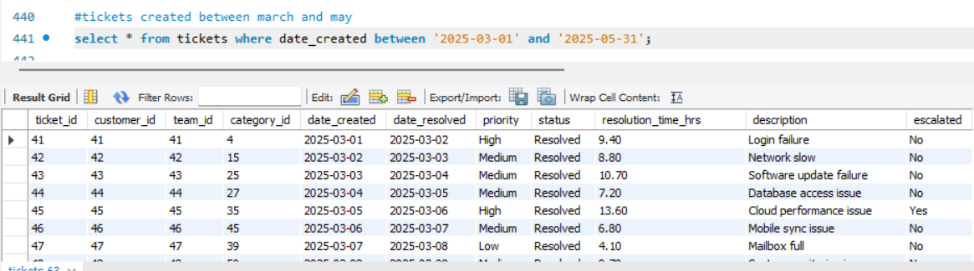
Having and between clause
Priorities having more than 10 tickets
Tickets created between march and may

Slide 17
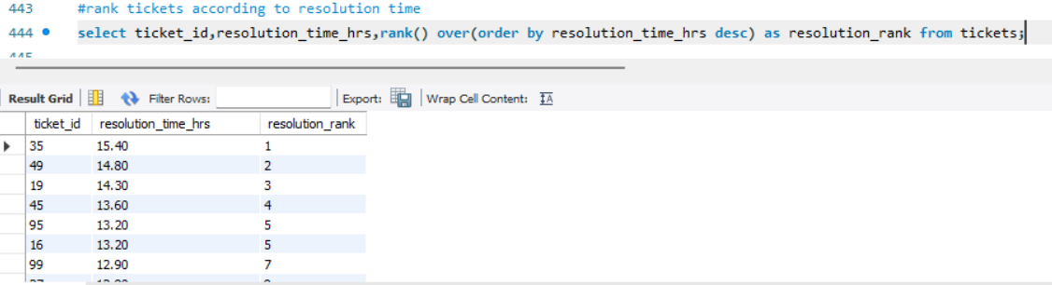
Rank function
Rank tickets according to resolution time

Slide 18
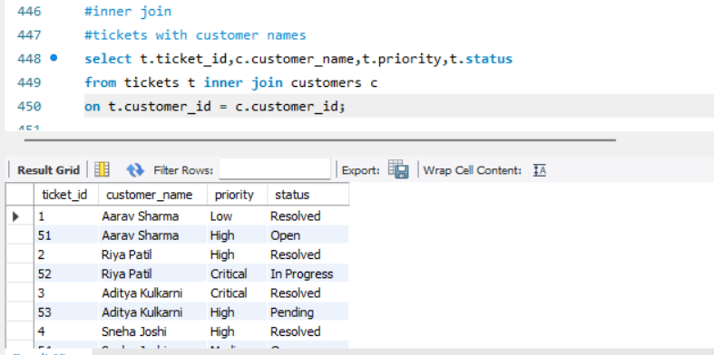
Joins
Inner Joins
Tickets with customers names

Slide 19
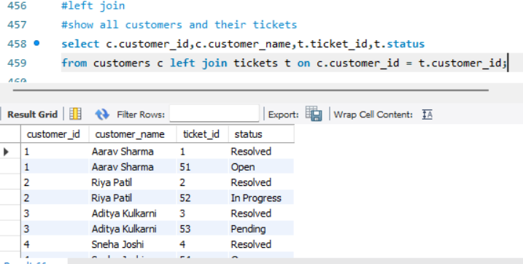
Left join
Show all customers and their tickets

Slide 20
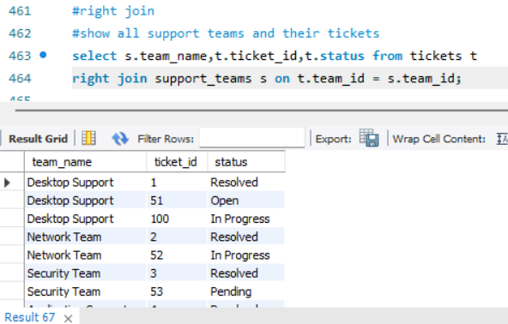
Right join
show all support teams and their tickets

Slide 21
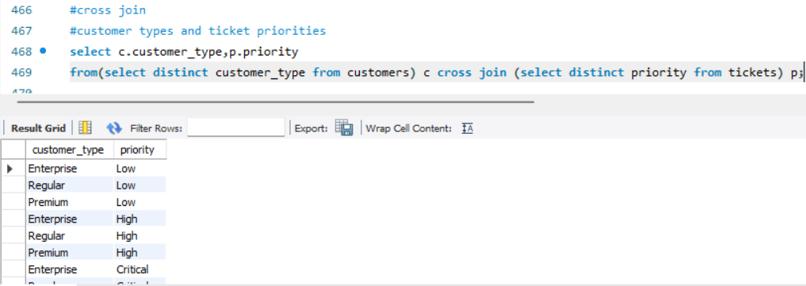
Cross join
customer types and ticket priorities

Slide 22
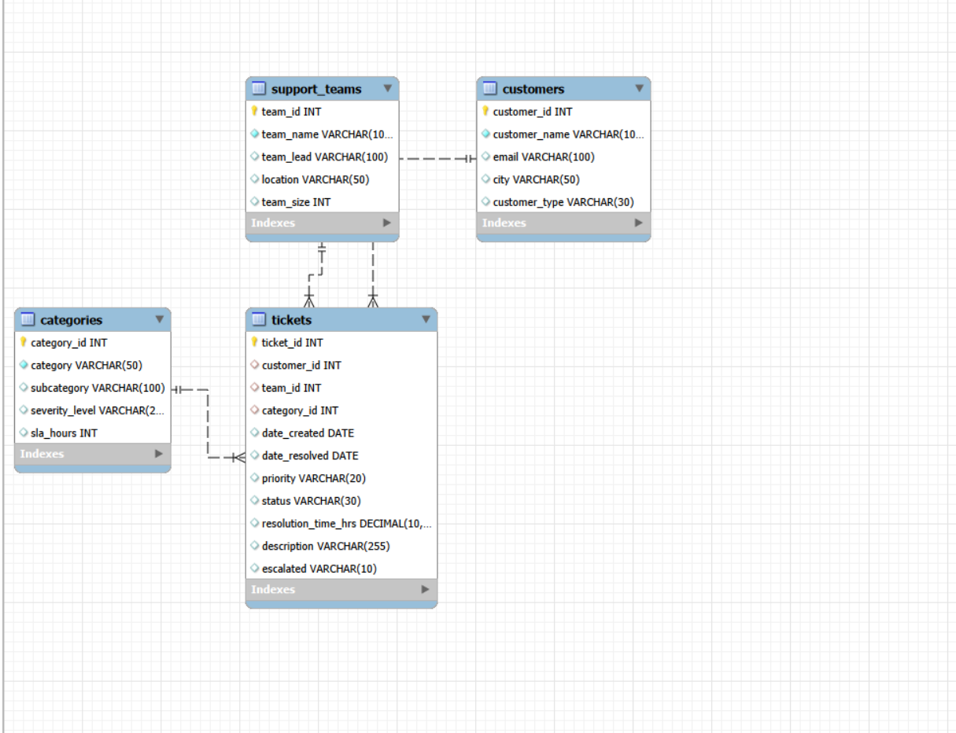
Entity Relationship Diagram

Slide 23
Conclusion
The project uses SQL to manage and analyze helpdesk tickets. It provides insights into ticket status, priority, categories, resolution time, and team performance, helping in better decision-making and support management.

Slide 24


